Slide 1
Introduction – ATC simulation
Casper Dek & Dennis van der Hoff
^{03/03/2020}

Slide 2
Planning of today
Familiarize with BlueSky, sector, airspace and tasks
Test procedures individually: land some aircraft (using fast-forward)
Perform some tests as a group
Perform first simulation
Evaluation
Perform second simulation

Slide 3
Role division
Michiel & Dennis
Bart, Kevin
Kees
Jordy
Midas
Thomas
Jacomijn
EHAM Arrivals
EHAM Departures
EHRD (20-5)
EHEH (8-7), EHBK (6-0), EHGR (0-1)
Military: EHVK (12-17)
East: EHLE (9-5), EHHO (1-0), EHTE (1-0)
North: EHKD (5-3), EHLW (1-1), EHGG (2-2),
73
44
25
22
29
16
14

Slide 4
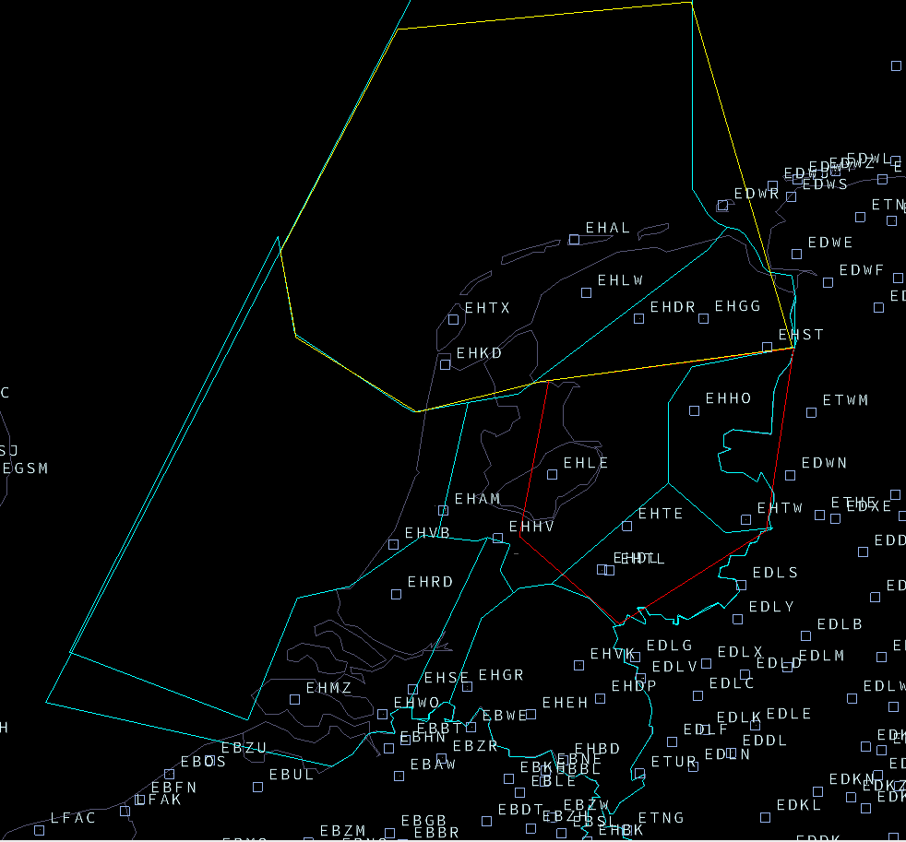
Role division

Slide 5
Available materials
SID / STAR maps
List of arriving and departing a/c per airport
List of scenario files available – on laptop Casper
List of color codes
List of common commands
ZIP file containing all scenario files and aforementioned documents

Slide 6
BlueSky Commands
‘klm914 call eham/star-denut’
‘addwpt klm914 norku’ / ‘klm914 addwpt norku’ → always at end of rte, before dest
‘listrte klm914’
‘direct klm914 norku’ [already in FMS]
‘klm914 after norku masos’
‘klm914 delwpt norku’
spd/hdg/alt
‘lnav on’ --> ‘vnav on’
‘asas on’, ‘taxi off’

Slide 7
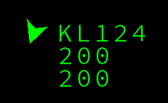
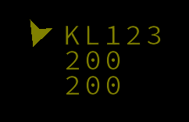
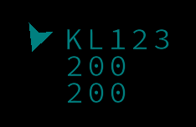
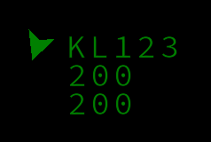
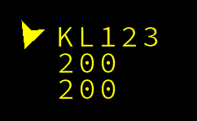
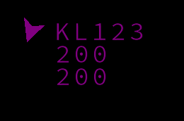
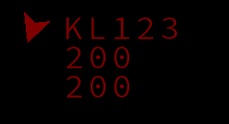
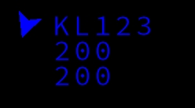
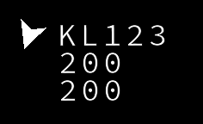
Color codes
Undefined Lime
EHAM Arrivals Olive
EHAM Departures Teal
EHRD Green
EHLE Yellow
EHEH, EHBK & EHGR Purple
EHVK Maroon
Other North (EHLW, EHGG, EHHO, EHTE) Blue
Spare White

Slide 8
General procedures
Everyone is responsible for its own airport and the surrounding area
Once an aircraft is created in BlueSky: assign a procedure using ‘call’: color changes and it will have a route now
Notify each other when ‘your’ aircraft crosses the area of someone else
Pause the simulation when necessary
Talk!!!

Slide 9
General procedures
Metrics are only calculated within the Dutch FIR
No need for separation outside the FIR, focus!
No need to worry about distances travelled outside the FIR
Distance, number of aircraft landed, convergence
Aircraft are deleted below 1500 ft (taxi on) – but ensure to decrease speed!

Slide 10
Familiarizing
Use ZIP file
Call ’startfile’
Perform some landings/departures at your airport
Use STAR and SID charts
You can use the network to simulate together
‘python3 BlueSky.py --headless’
‘python3 BlueSky.py --client’ -- Both!

Slide 11
Starting the simulation
Connect with wi-fi:
Network:
Password:
Start BlueSky as a client (‘python3 BlueSky.py --client)
Find the correct host and connect
You should be able to see aircraft now
We will simulate for 1 hour (BlueSky-time)

